Slide 1

Multi-Tenancy Framework

Slide 2
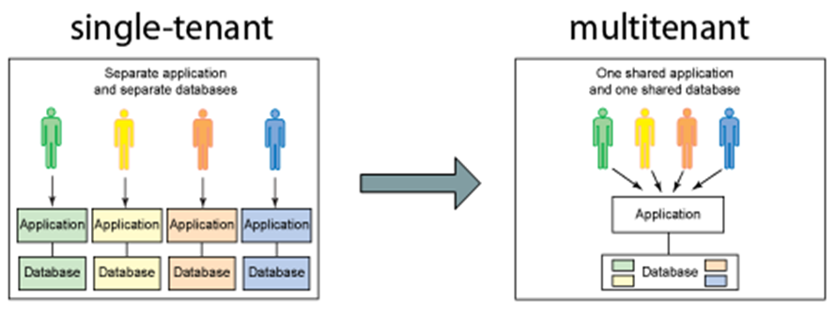
The term "software multitenancy" refers to a software architecture in which a single instance of software runs on a server and serves multiple tenants. A tenant is a group of users who share a common access with specific privileges to the software instance

Slide 3
Rule Engine:-
To define the rules performed against each tenant.
Includes,
What are all the preparations to be performed.
Includes validations, any external calls, framing the data for DB execution.
What are all the data to be saved.
User info, Vehicle info, Partner info ..etc.
Where the data to be saved.
DB instance, may be On-premSQL or AzureSQL.
Where the data to be published.
For marketing purpose, may be MDM, CRM or any SCA-C application.
Example:-
NA-Mobile-RuleEngine
NA-Web-RuleEngine
CN-RuleEngine
MMJP-RuleEngine
EU-RuleEngine

Slide 4
NA-Mobile-RuleEngine
Preparation Layer - Preprocessor
CapUserId Manager
Asynchronous process - All the sections executed parallely and results will be joined.
Address Validator
VinDecode Manager
ACC Pref Manager
Phone Validator
Sequential process - Trigger and wait for result.
DB Execution - Save or Retrieve the data.
Asynchronous process - Trigger this section and move on.
Publish Data - Send to MDM.

Slide 5
ACC Pref Manager
CapUserId Manager
Address Validator
NA-Mobile-RuleEngine
CN-RuleEngine
EU-RuleEngine
Preparation Layer - Preprocessor
Preparation Layer - Preprocessor
Preparation Layer - Preprocessor
CapUserId Manager
CapUserId Manager
CapUserId Manager
Address Validator
Address Validator
Address Validator
VinDecode Manager
Baidu Validator
NationalID validator
ACC Pref Manager
ACC Pref Manager
MKT Pref Manager
NA-Phone Validator
CN-Phone Validator
EU-Phone Validator
DB Execution - Save or Retrieve the data.
DB Execution - Save or Retrieve the data.
DB Execution - Save or Retrieve the data.
Publish Data - Send to MDM.
Publish Data - Send to SAP CRM.
Publish Data - Send to some SCA-C system.

Slide 6
NA-Mobile-RuleEngine
CN-RuleEngine
Preparation Layer
CapUserId Manager
Preparation Layer
Address Validator
VinDecode Manager
ACC Pref Manager
NA Phone Validator
CN Phone Validator
Baidu Validator
DB Execution - Save or Retrieve the data.
DB Execution - Save or Retrieve the data.
WeChat Manager
Publish Data - Send to MDM.
MKT Pref Manager
Publish Data - Send to SAP CRM.

Slide 7
NA-Mobile-RuleEngine
CN-Mobile-RuleEngine
Preparation Layer
Required validations
Preparation Layer
extends
MasterRuleEngine - It’s an abstract class holding shared methods
extends
implements
DB Execution - Save or Retrieve the data.
DB Execution - Save or Retrieve the data.
RuleEngineInterface - Interface defining mandatory methods for rule engine
Publish Data - Send to MDM.
Publish Data - Send to SAP CRM.

Slide 8
NA-Mobile-RuleEngine
preferences = “ACC”, “MKT”
List getPreferences() {
return preferences;
}
Preference Validator
isValidPref(masterRuleEngine, givenPref) {
return masterRuleEngine
.getPreferences()
.contains(givenPref);
}
CN-Mobile-RuleEngine
preferences = “ACC”
List getPreferences() {
return preferences;
}
Preparation Layer
Preparation Layer
extends
masterRuleEngine instance
abstract MasterRuleEngine
abstract List getPreferences();
extends
implements
DB Execution - Save or Retrieve the data.
DB Execution - Save or Retrieve the data.
RuleEngineInterface - Interface defining mandatory methods for rule engine
Publish Data - Send to MDM.
Publish Data - Send to SAP CRM.

Slide 9
To share data from preparation layer to DB execution layer,
NA-Mobile-RuleEngine
Preparation Layer
CapUserId Manager
User Account details
Request Scope Memory
Address Validator
VinDecode Manager
Vehicle details
ACC Pref Manager
Request Scope Memory
Phone Validator
User Account details
Vehicle details
DB Execution - Save or Retrieve the data.
Publish Data - Send to MDM.

Slide 10
MCAPC01_APP_CODE Table:-
To identify the rule engine for given request,
NA-Mobile-RuleEngine
group_types = “MOBILE_NA”
APP_CODE(PK) | VALIDATION_GRP_CODE
100504 | MOBILE_NA
100201 | WEB_NA
100581 | MMJP
APP_CODE(PK) | VALIDATION_GRP_CODE
100504 | MOBILE_CN
100201 | WEB_CN
100581 | MMJP
NA-Web-RuleEngine
group_types = “WEB_NA”
CN-RuleEngine
group_types = “MOBILE_CN”, “WEB_CN”
Request with appCode
Fetch ValidationGroupCode from “App_Code” table
MMJP-RuleEngine
group_types = “MMJP”
RuleEngine instance
Identify an appropriate rule engine by iterating all rule engines and match group type.

Slide 11
To isolate the user profiles in the table,
MCAPC01_APP_CODE Table:-
APP_CODE(PK) | TENANT_ID
100504 | 1
100201 | 1
100581 | 3
APP_CODE(PK) | TENANT_ID
100504 | 2
100201 | 2
100581 | 2
MCAPP01_USER Table:-
GUID(PK) | TENANT_ID(PK) | APP_CODE | LAST_UPD_APP_CODE
123-123 | 1 | 100504 | 100504
123-123 | 3 | 100581 | 100581
GUID(PK) | TENANT_ID(PK) | APP_CODE | LAST_UPD_APP_CODE
123-123 | 2 | 100504 | 100504
GUID(PK) | TENANT_ID(PK) | APP_CODE | LAST_UPD_APP_CODE
123-123 | 2 | 100504 | 100201
GUID(PK) | TENANT_ID(PK) | APP_CODE | LAST_UPD_APP_CODE
123-123 | 1 | 100504 | 100201
123-123 | 3 | 100581 | 100581
GUID(PK) | TENANT_ID(PK) | APP_CODE | LAST_UPD_APP_CODE
123-123 | 2 | 100504 | 100581

Slide 12
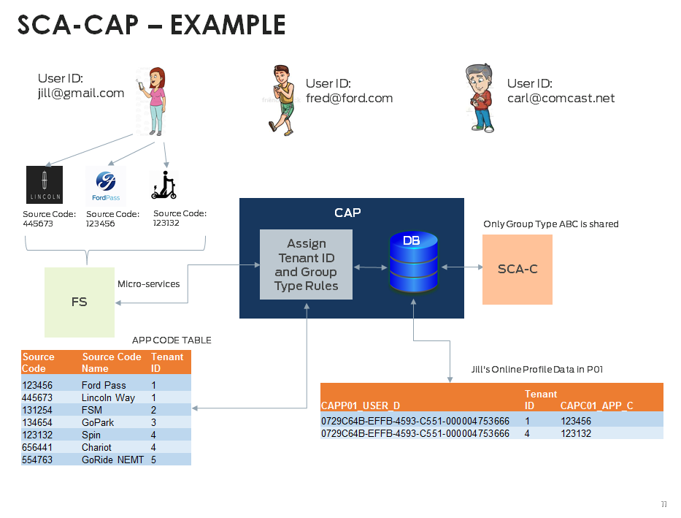

Slide 13
So APP_CODE table looks like,
MCAPC01_APP_CODE Table:-
APP_CODE(PK) | TENANT_ID | VALIDATION_GRP_CODE
100504 | 1 | MOBILE_NA
100201 | 1 | WEB_NA
100581 | 3 | MMJP
APP_CODE(PK) | TENANT_ID | VALIDATION_GRP_CODE
100504 | 2 | MOBILE_CN
100201 | 2 | WEB_CN
100581 | 2 | MMJP
TENANT_ID :- To group app_codes as one Tenant and so acting as an distinguisher between same user profile that accessed by different app_code groups.
Since “TENANT_ID” is the distinguisher, all records/data related to GUID will also be associated to “TENANT_ID”. So all tables which has GUID as the column, will also have “TENANT_ID” column. It will be indexed as if like GUID.
Rules here:
A single source code can only be associated with one Tenant ID
A single tenant ID can contain multiple source codes (App IDs)
A user profile is identified by “GUID” and “Tenant ID” combination
VALIDATION_GRP_CODE :- To decide rules that app_code has to follow.

Slide 14
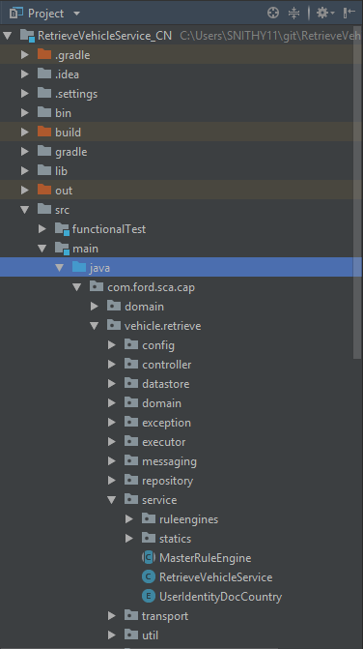
Package Structure:-
“com.ford.sca.cap” - Files that are shared across all projects in CAP. Primarily for accessing files via redis cache.
“com.ford.sca.cap.vehicle.maintain” - Files specific to maintain vehicle service.
“com.ford.sca.cap.vehicle.retrieve” - Files specific to retrieve vehicle service.
“com.ford.sca.cap.vehicle.delete” - Files specific to delete vehicle service.

Slide 15
Miscellaneous:-
@ScaCapApiResponses - A short form for list of API responses in the CAP.
@LogAround - To log IN, OUT and TIME TAKEN for the public method. Not for private method.
LoggerBuilder - To build logger message in code assister run, also asynchronous.
CheckStyle - For code formatting and it follows GOOGLE_STYLE template. Template xmls for STS and Intellij also provided. Gradle build will fail if code formatting is not followed.
Findbugs - Code quality task finding dereferences, naming conventions… etc. Gradle build will fail if these standards not followed.
Jacoco - Ensuring code coverage by unit testing. Minimum is 85% on instruction and branch coverage. Gradle build will fail if code coverage is not met.
PMD - Code quality task ensuring universal standards as like sonarqube. Covers almost 90% of the FORD standard sonarqube rules. Again Gradle build will fail if its violated.
gradlew build -P <env> - To build custom artifacts based on the tenant implementation. Ex - “NA”, “CN”.

